Slide 1
M. C. Lang Fellowship in Book History, Bibliography, and Humanities Teaching with Historical Sources
Informational Session
23 October, 2024

Slide 2
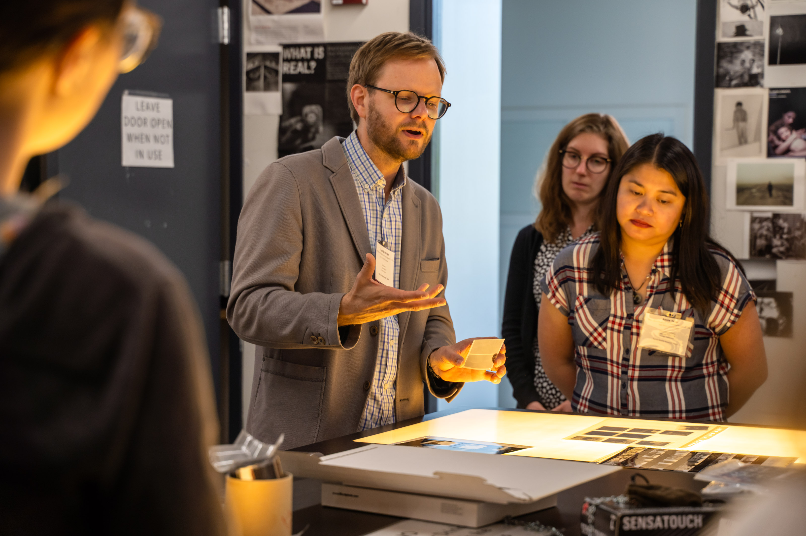
About the Fellowship
Mr. Michael Lang’s goal in creating this fellowship program is to reanimate humanities teaching by equipping educators with the skills to enlarge their students’ historical sensibilities through bibliographically informed instruction with original historical sources.
In particular, humanities teaching at liberal arts colleges and small universities.
Inculcate wonder!

Slide 3
The Fellowship Includes
Two Rare Book School Courses
  One course in each year of the two-year program (more on this in a minute)
  Tuition is waived
Annual stipend of $1500 for travel, housing, and food
Matching funds of up to $1000 each year of the Fellowship program
  Matched by the Fellow’s home institution
  Build the book-historical community at home institution
    Examples: teaching collection, vitrines for exhibition space, speaker series, symposium, etc.
  Projects may be undertaken with other Lang Fellows

Slide 4
Building Community
Lang fellows will take two Rare Book School courses, and will, in turn, be charged with building a book-historical community at their institution. The Fellows will also be given opportunities to build a community within their cohort; a support system.
"[The H-165 class] has the two-fold benefit of being a chance to learn from an RBS faculty member and to learn from the other educators in the course simultaneously. I feel that Michael Suarez imparted a lot of information to us about how to teach, the importance of bibliographic and book historical approaches, and skills on how to leverage that knowledge to educate undergraduates. Additionally, this Lang cohort has been a really marvelous resource that I have felt forming over this week and that I look forward to continuing to rely on after this." ~A current Lang Fellow

Slide 5
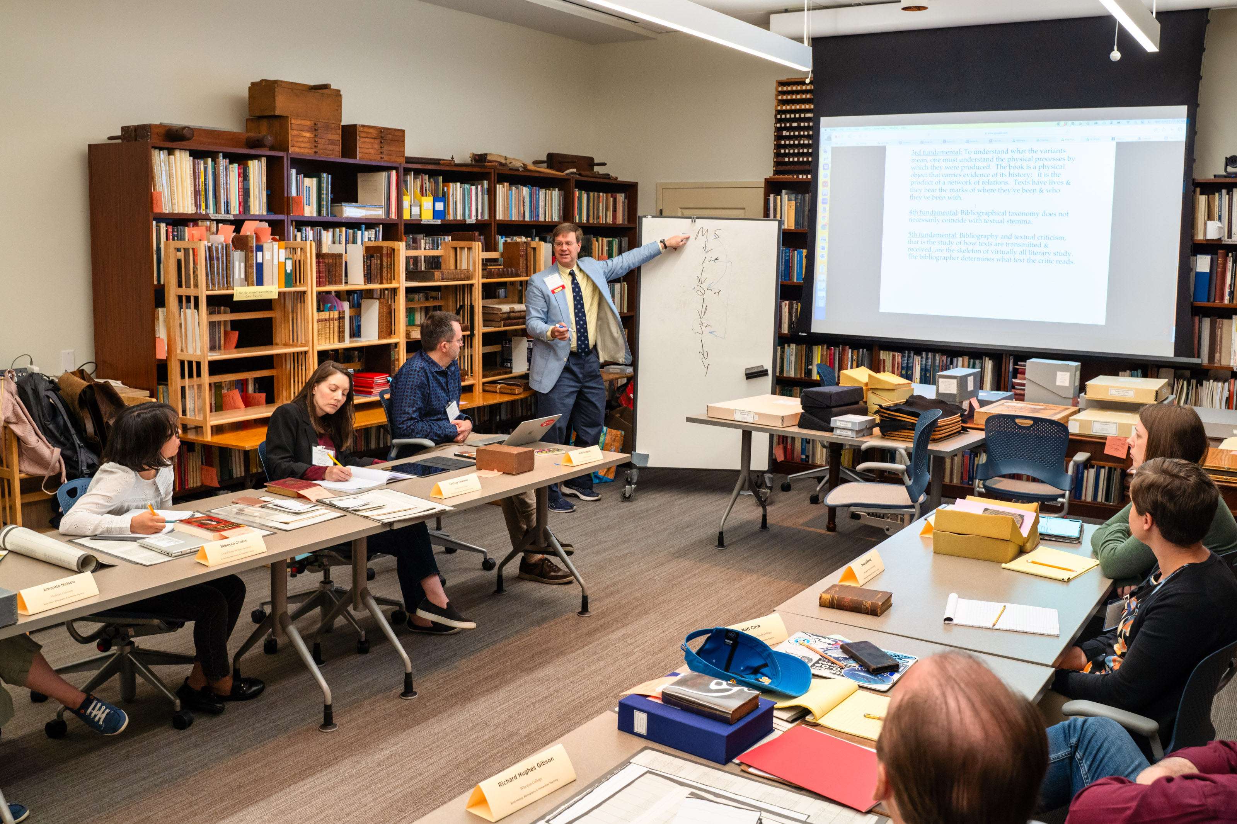
The Courses
The first course must be H-165 Book History, Bibliography, and Humanities Teaching
  Fellows must be able to take this course during the set week in their first year (June 2025)
  Guaranteed admission, open only to Lang Fellows
The Second course is an elective
  Can take equivalent of one full-length course (i.e. two short online courses)
  Cannot take H-90 Teaching the History of the Book

Slide 6
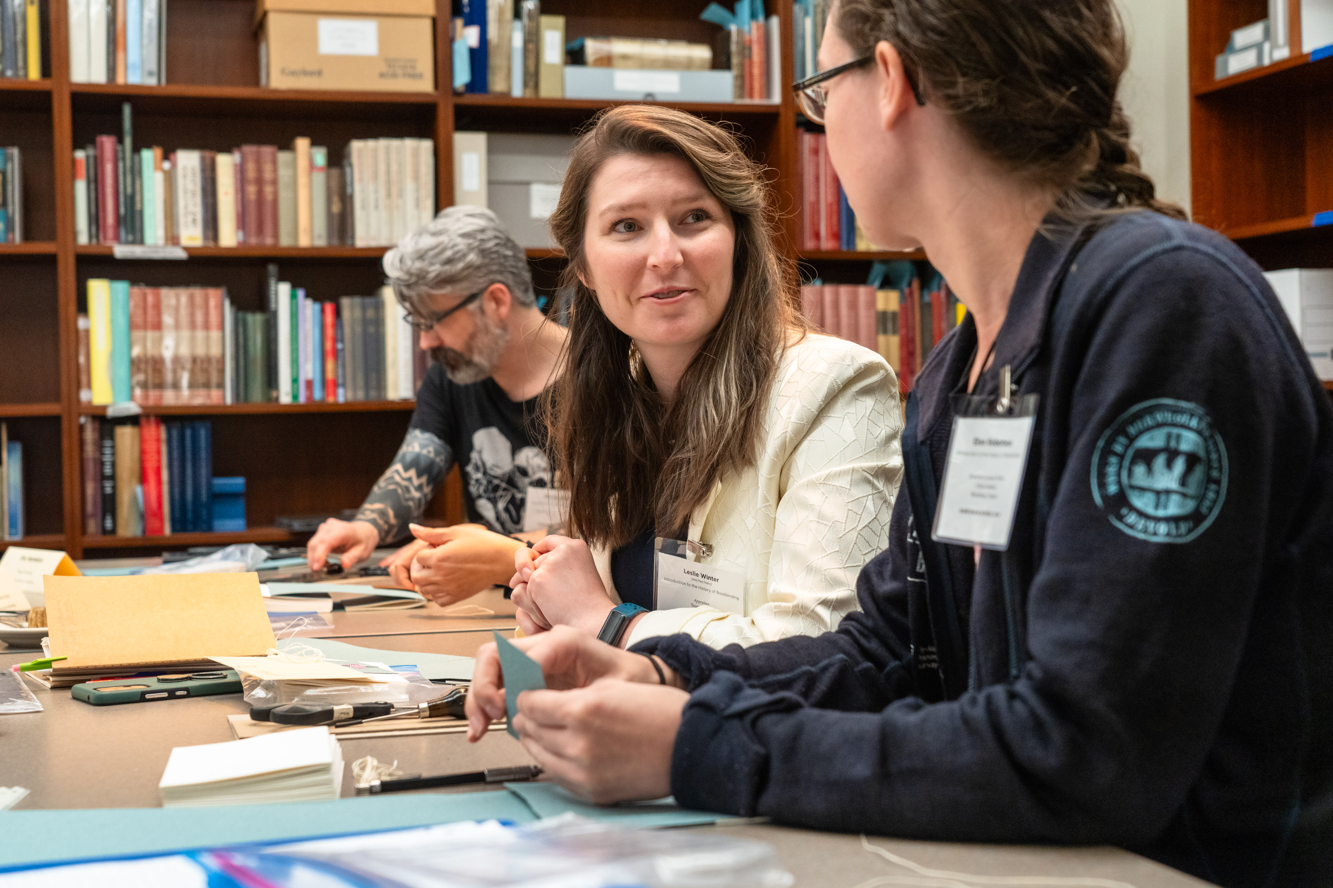
The Multiplier Effect

Slide 7
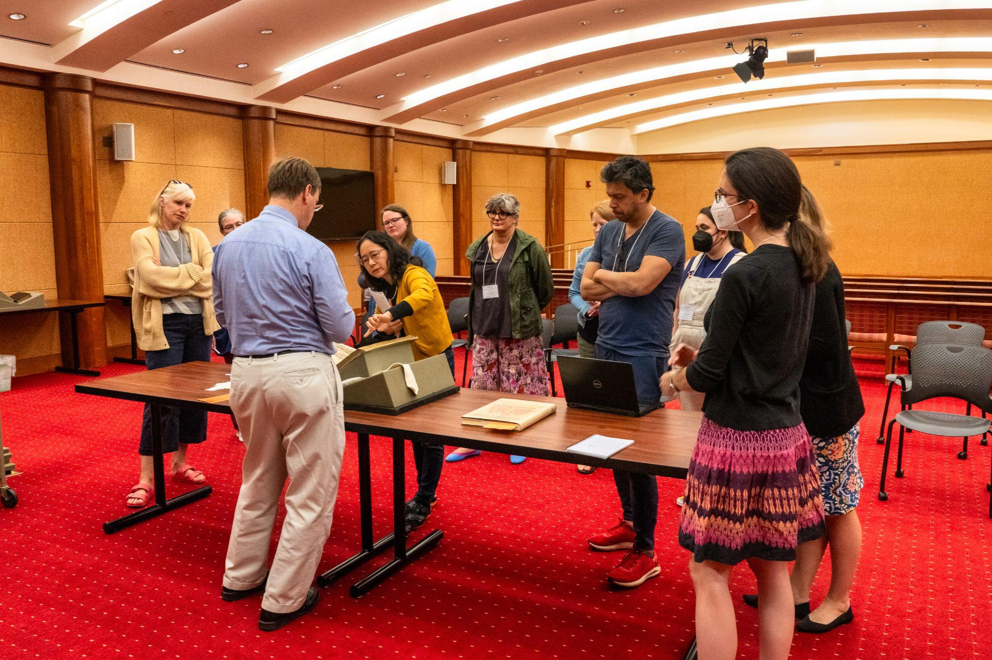
Humanities Teaching with Historical Sources
"Watching Michael Suarez teach in Special Collections with rare books helped give me new ideas as to how I might approach teaching with special collections materials (in both similar and different ways!).
I also appreciated that Suarez emphasized collaboration as part of the Lang Fellowship—between faculty and librarians, across campus, &c. The conversation on how we will transform book historical culture on our campus with the matching funds gave me ideas on both projects for how to spend the money, and who to approach as partners/collaborators." ~A current Lang Fellow

Slide 8
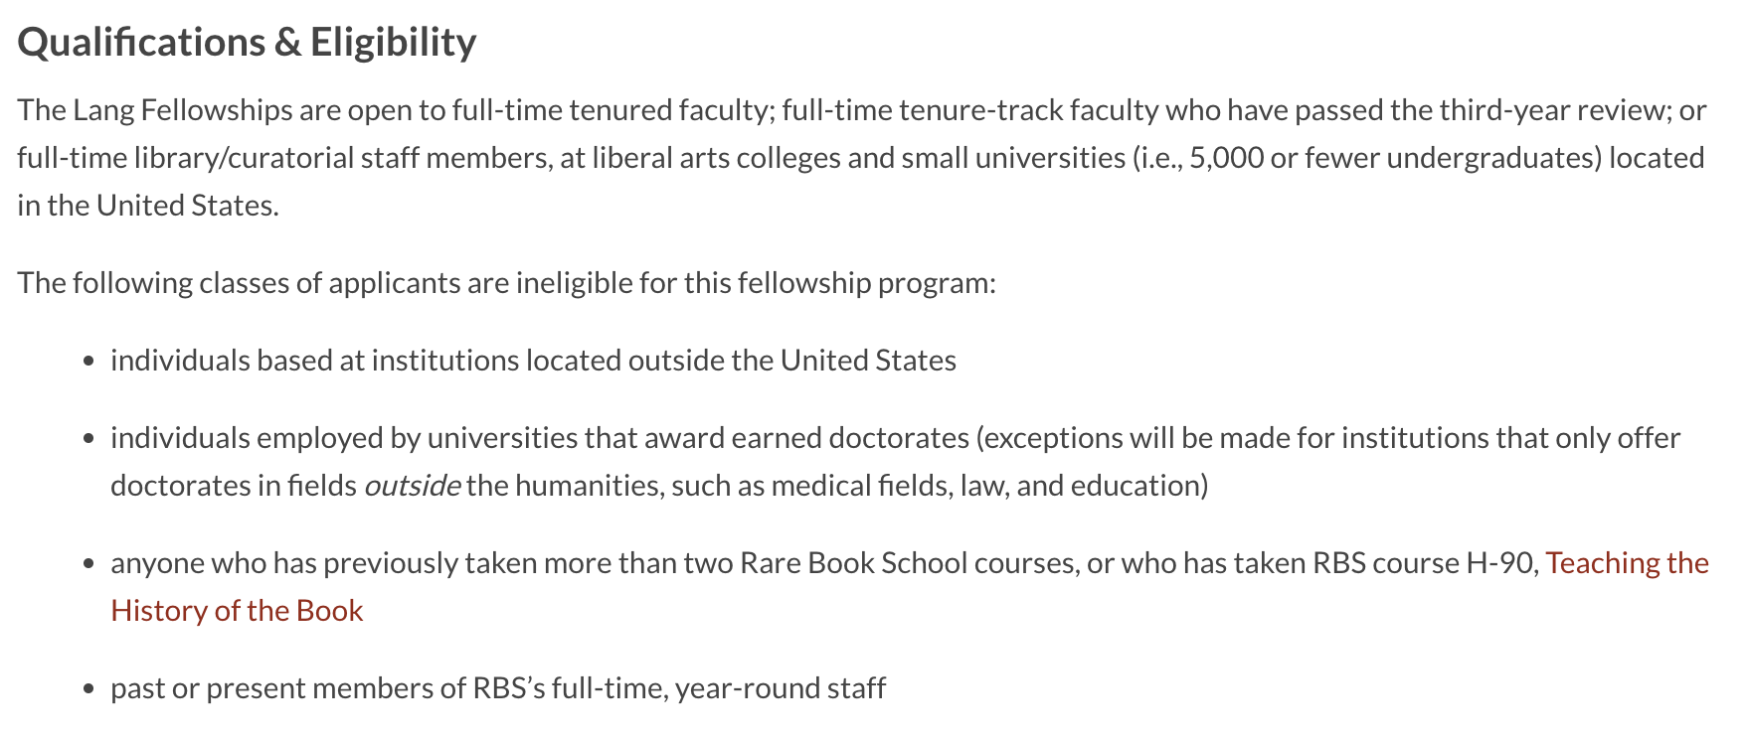
Eligibility

Slide 9
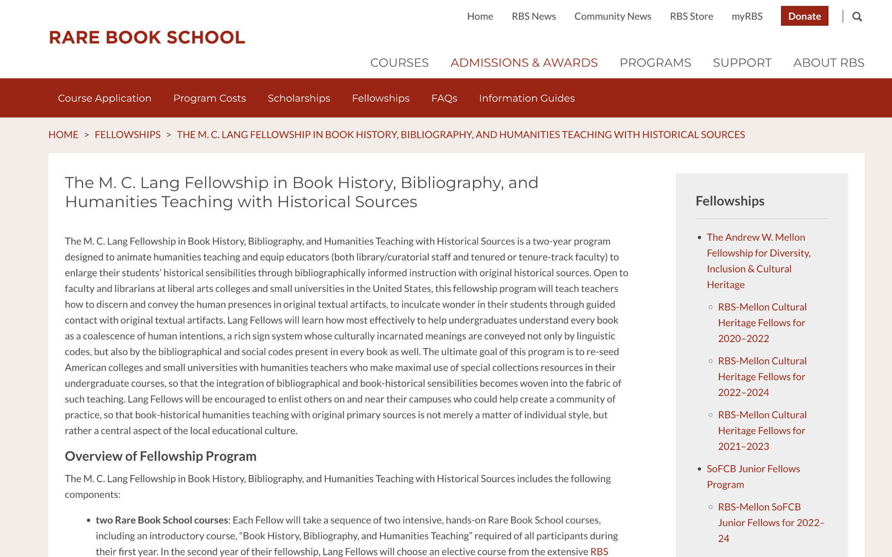
The Application Process
Go to rarebookschool.org
2. Click “MyRBS”
(upper right hand corner)
Detailed information and instructions can be found at:
https://rarebookschool.org/admissions-awards/fellowships/lang/

Slide 10
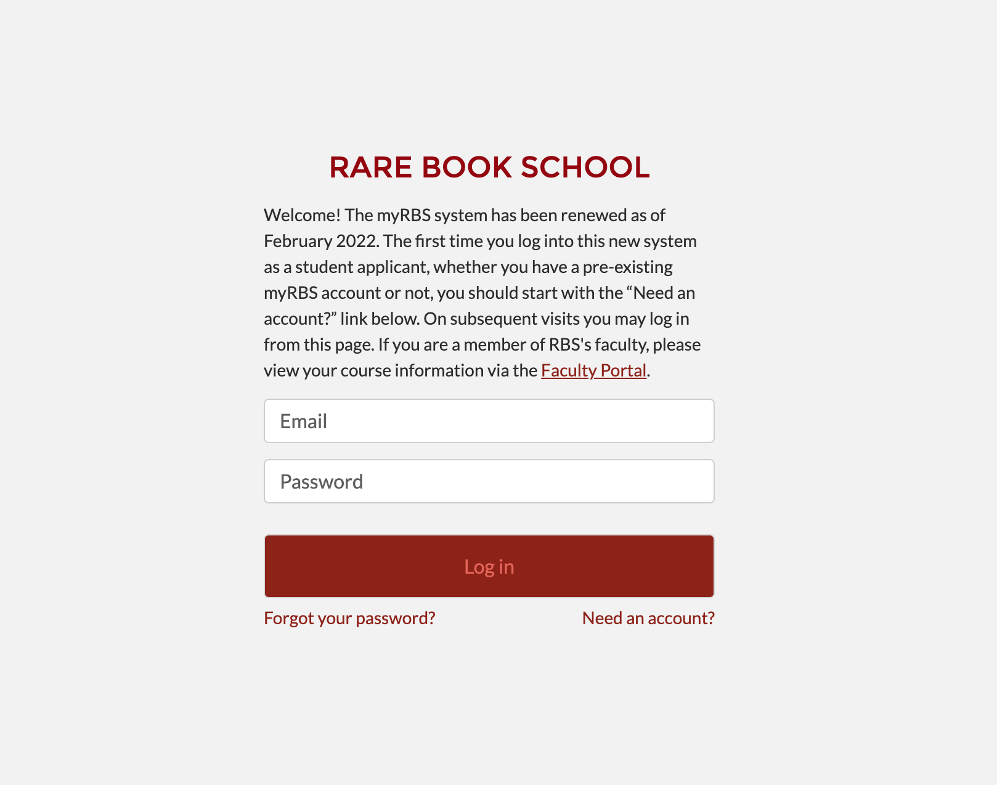
3. Log in with your MyRBS account information
First time users should click “Need an account?” (lower right)
MyRBS Log in page

Slide 11
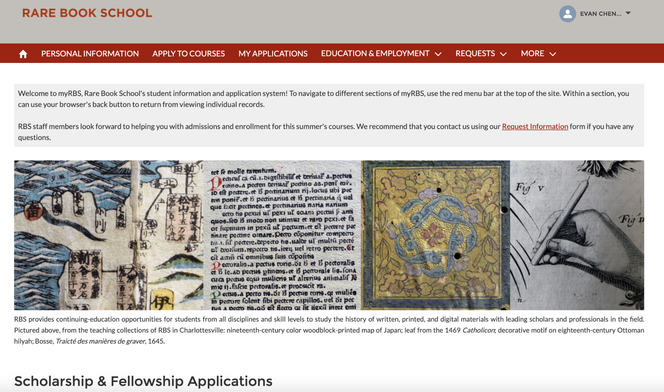
4. Scroll down
MyRBS Student Landing Page (after you log in)

Slide 12
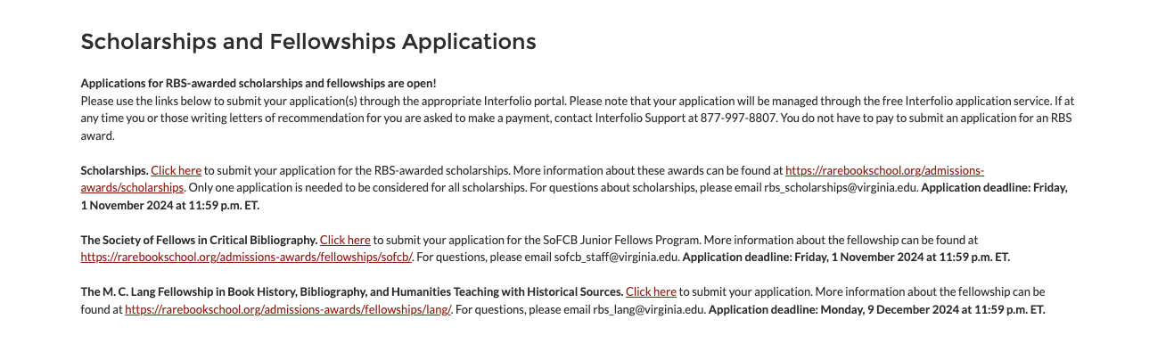
5. After scrolling down, the Lang Fellowship is the third option (after Scholarships and SoFCB)
MyRBS Scholarships & Fellowships
Click on link “Click Here” to apply for the Lang Fellowship

Slide 13
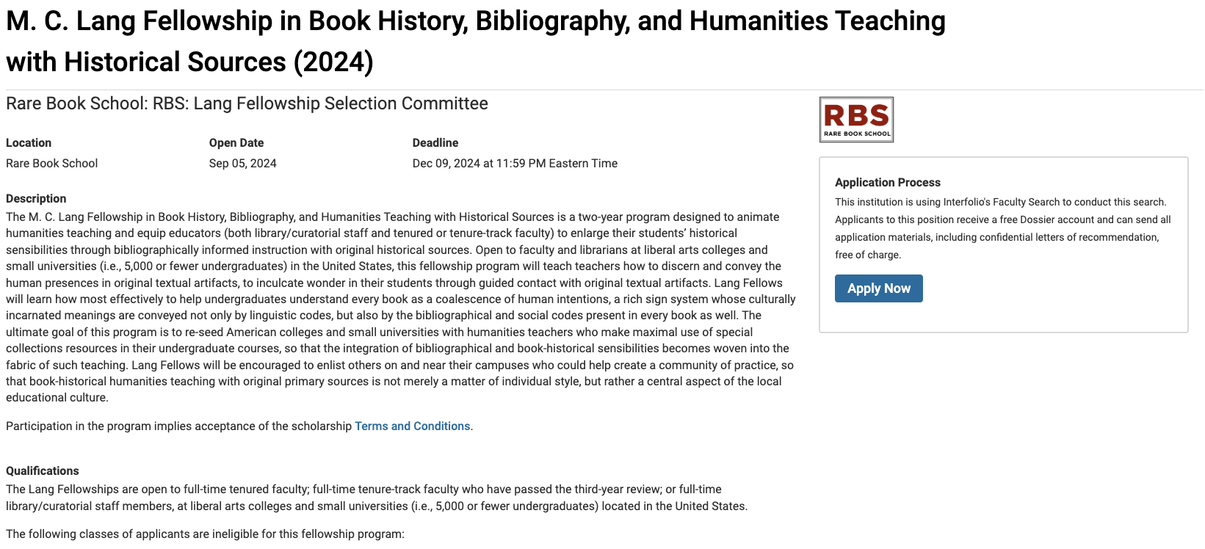
6. Click “Apply Now”
Lang Fellowship Landing Page

Slide 14
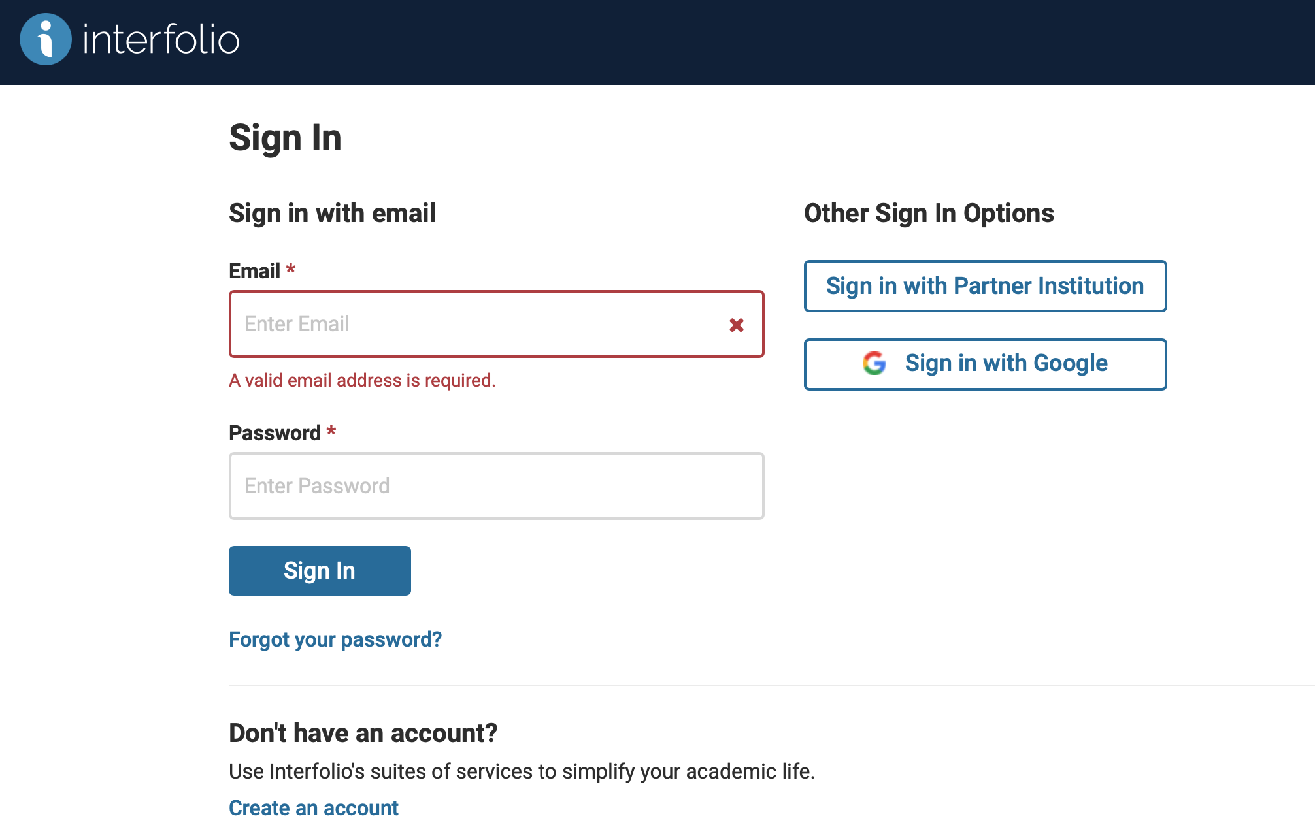
7. a) If you have an Interfolio Account, sign in
b) If you do not,
create an account
You do NOT need to pay
for an Interfolio account
Interfolio Log In Page

Slide 15
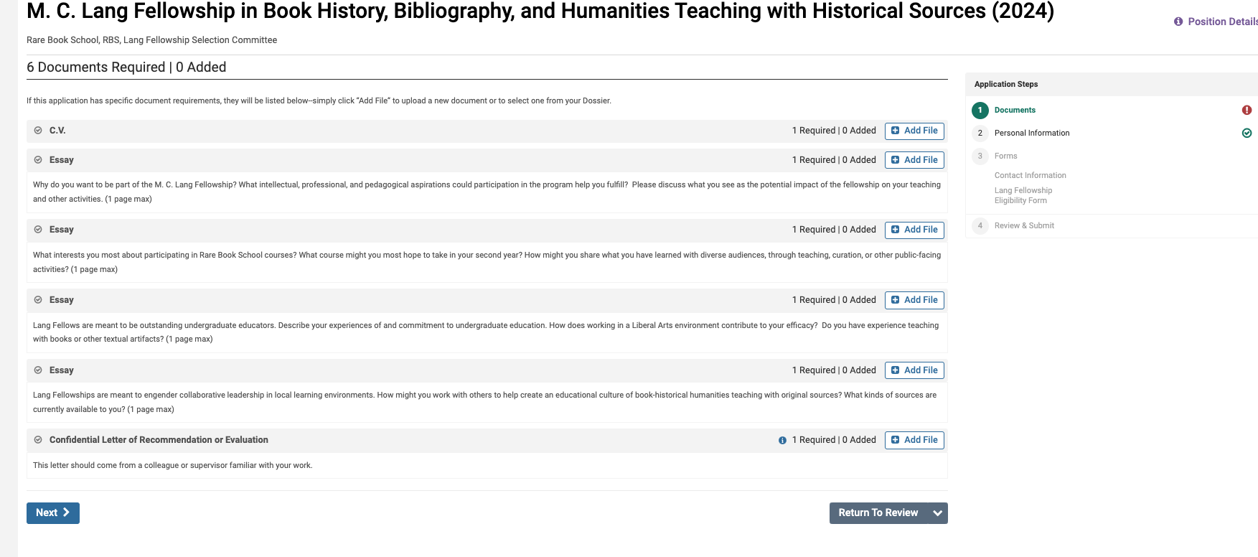
Landing Page in Interfolio

Slide 16
Application Materials
A brief contact information and eligibility form
A curriculum vitae
Invite a colleague to submit a confidential letter of recommendation
Four short essays, submitted as four documents (one page maximum, single spaced)
  Why do you want to be part of the M.C. Lang Fellowship?
  What interests you most about participating in Rare Book School courses?
  Describe your experiences of and commitment to undergraduate education. How does working in a Liberal Arts environment contribute to your efficacy?
  How might you work with others to help create an educational culture of book-historical humanities teaching with original sources?

Slide 17
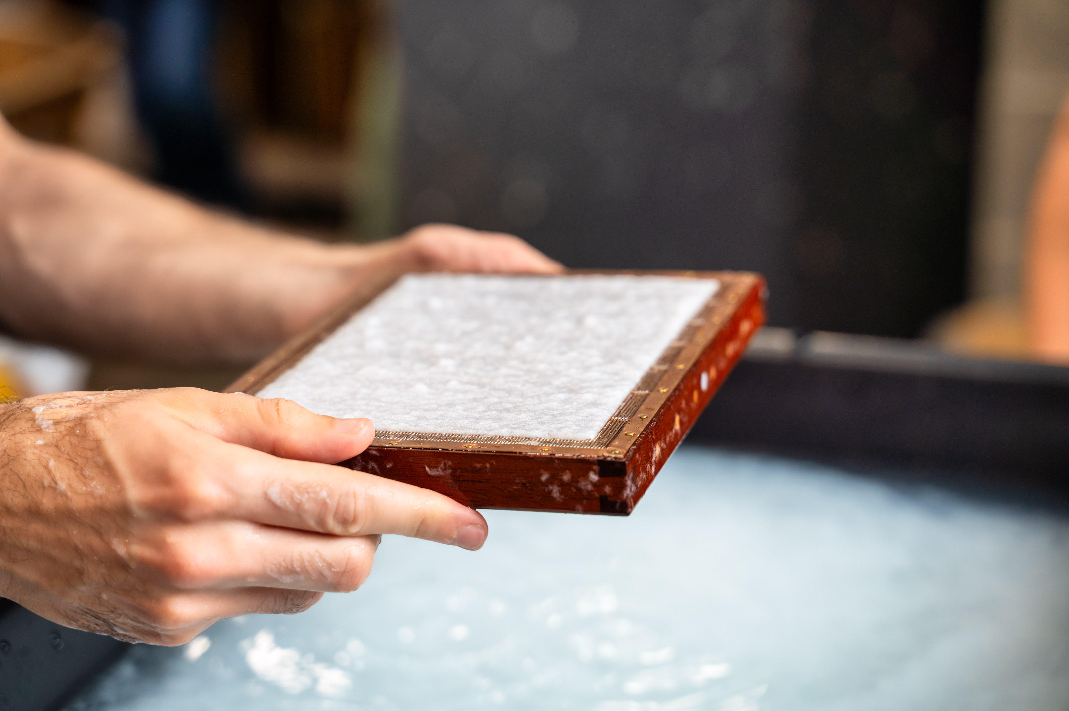
Letter of Recommendation
The letter should be written by a colleague who can speak to your suitability for the Lang Fellowship—to your teaching, outreach, impact potential, dedication to teaching with primary sources, bibliography, book history and inculcating wonder.
Advice: which recommender can give most recent, salient, and specific examples of your teaching with undergraduates, as well as your real and potential contributions to the hands-on study of the book?

Slide 18
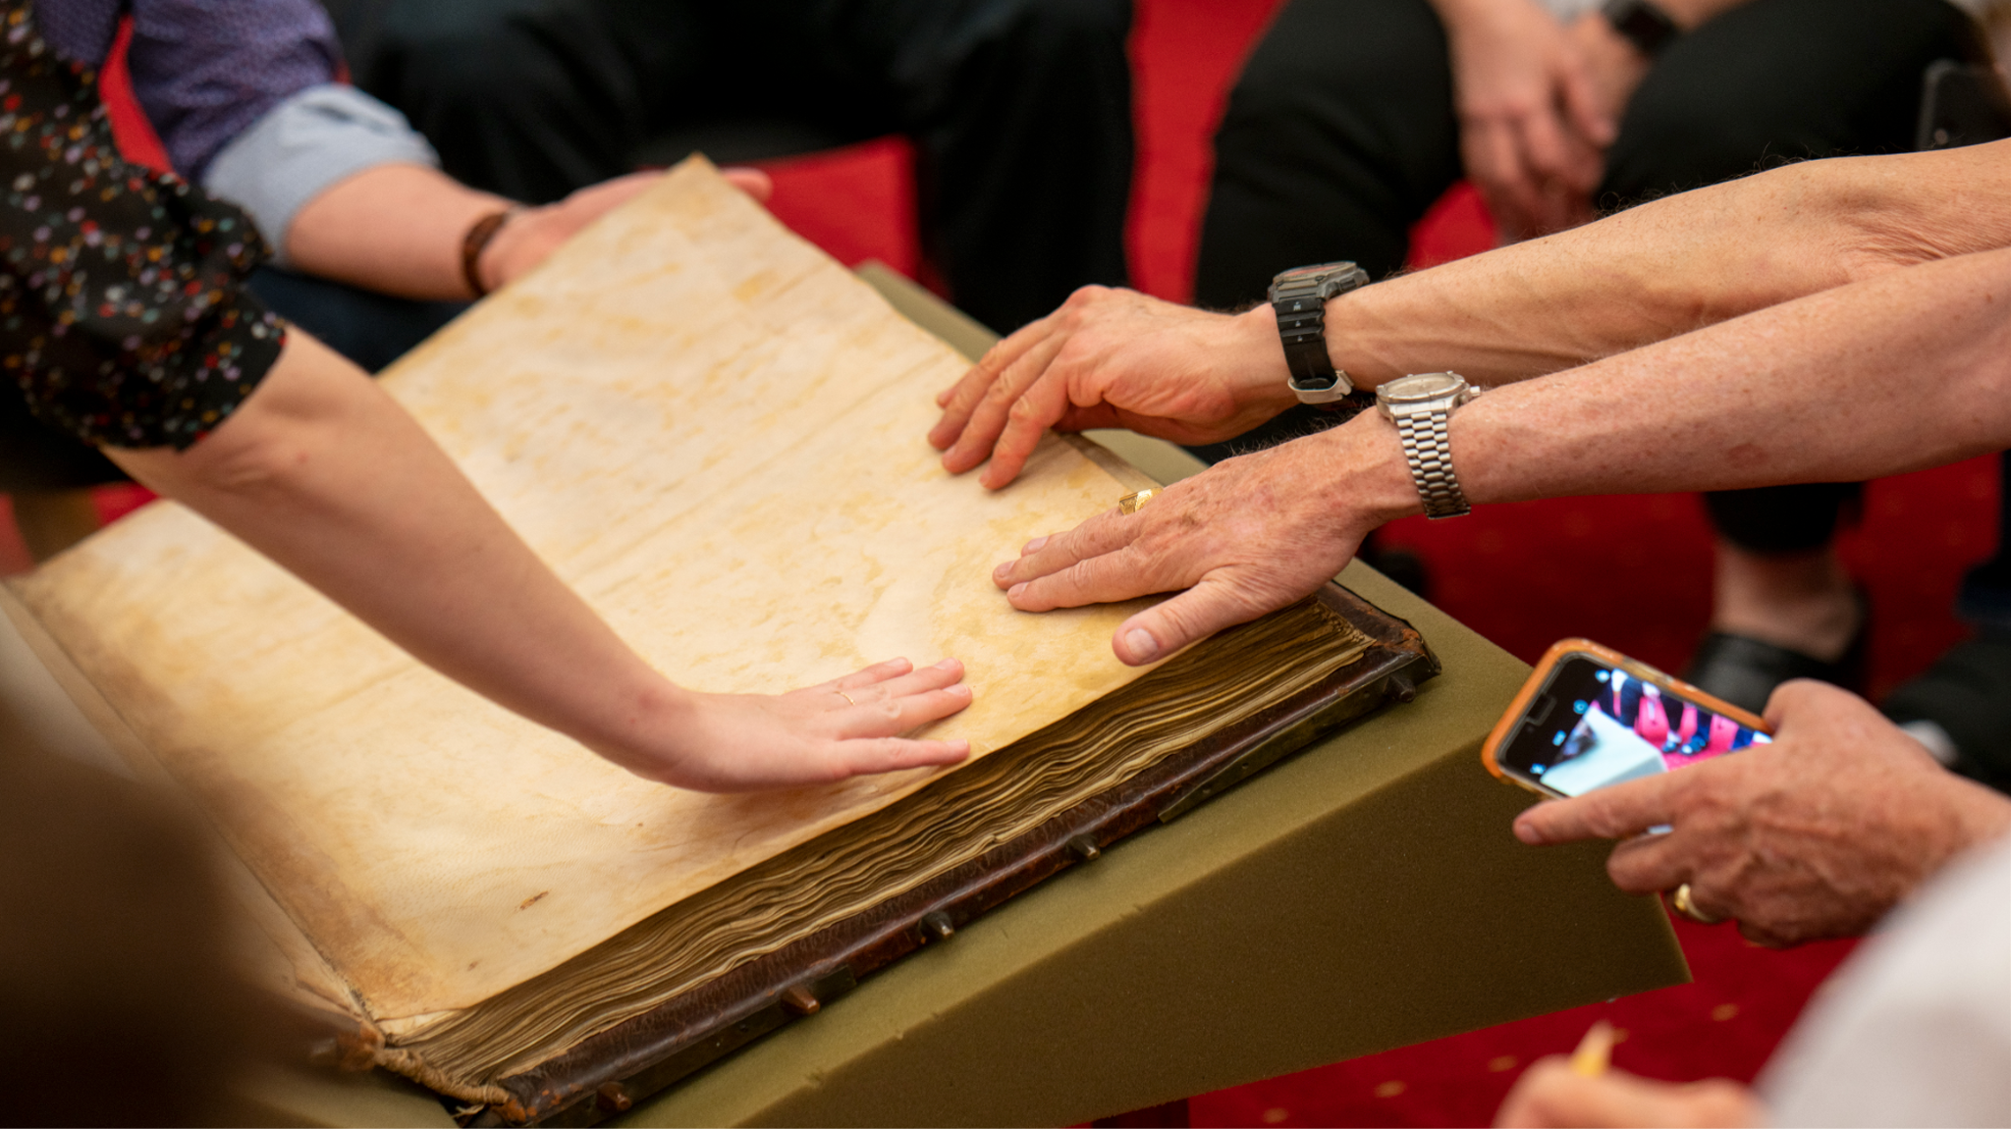
Helpful advice
The committee is looking more for how you will use what you learn with the undergraduates, rather than how you might share what you know through publications of your own research–though it is great if what you learn does help with your research and publications.

Slide 19
The Experience of Being a Lang Fellow
“The course H-165 demonstrated… through the exercises and object lessons—how creatively as well as deliberately one can teach. While I was hopeful that the class would be terrific, I had not anticipated how eye-opening it would be, a regenerative experience that will have ramifications well beyond my teaching in book history.” ~A past Lang Fellow
Recent Projects by Lang Fellows:
Book historical panel discussion
Faculty learning community (leading workshops, reading groups)
Transcribe-a-thon and speaker series
Speaker/workshop series (very popular)
Acquisition of materials for teaching collections

Slide 20

Direct any questions to:
rbs_lang@virginia.edu

